Slide 2
understand IBM InfoSphere Streams,
learn a new paradigm for information processing, learn powerful, real-time analytic processing made simple,
explore Enterprise integration and concepts of scale-out architecture,
comprehensive tools and Sophisticated analytics with toolkits,
learn InfoSphere Streams: System requirements.

Slide 3
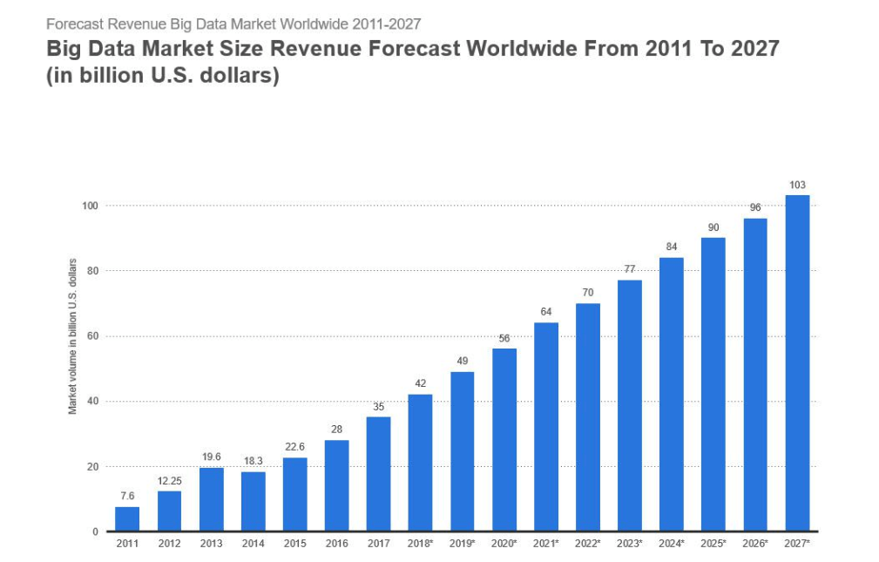
Introduction
Generate data at a pace

Slide 4

Introduction
30 petabytes of data through its network

Slide 5

Introduction
Dublin city center

Slide 6

Introduction
Twitter handles 340 million tweets daily

Slide 7
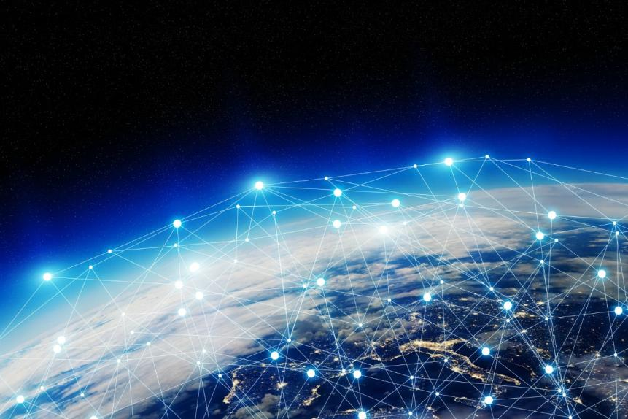
Introduction
Annual Internet traffic is expected to reach 1.3 zettabytes

Slide 8

Introduction
Today’s organizations are challenged to make informed, real-time business decisions

Slide 9

Introduction
1. Extend the value of their existing systems
2. Generate significant business advantages

Slide 10
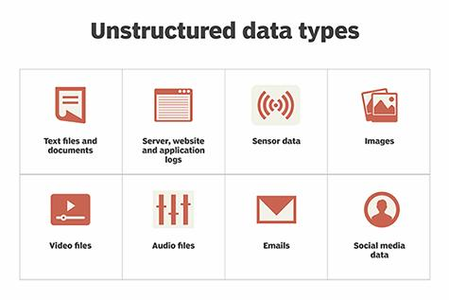
Introduction

Slide 11
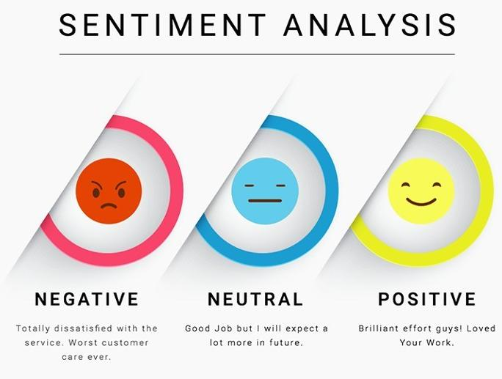
Changes in customer sentiment
Totally dissatisfied with the service. Worst customer care ever.
Good Job but I will expect a lot more in future.
Brilliant effort guys! Loved Your Work.

Slide 12
Introduction
TECHNOLOGY
What new technologies will be a part of our future?
TRENDS
What megatrends do wee see on the horizon?
Market Opportunities
OUR IDEAS
Internal Innovation Project
CUSTOMER NEEDS
Uncover and understand today’s and tomorrow’s customer needs

Slide 13

Introduction

Slide 14
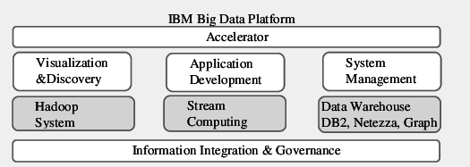
Introduction

Slide 15
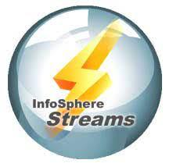
Introduction
Capture and act on key business data

Slide 16

A new paradigm for information processing
Pioneering work from IBM Research

Slide 17
A new paradigm for information processing
Enables organizations to develop and execute applications that
ingest
filter
correlate massive volumes of continuous data streams
analyze
t

Slide 18
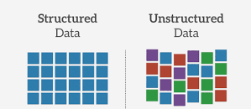
These data streams can come from both structured and unstructured data sources, and they can contain a wide range of digital data, including:

Slide 19
A new paradigm for information processing
Spreadsheets
Images,
Video
Audio recordings
Text files

Slide 20
A new paradigm for information processing
Email,
Chat
Instant messages,
Web traffic
Blogs
social networking sites

Slide 21
A new paradigm for information processing
Financial transactions,
customer service records,
telephone usage records,
system
application logs

Slide 22
A new paradigm for information processing
Data from satellites,
GPS tracking,
Smart devices
Network traffic sensors

Slide 23

A new paradigm for information processing
Powerful data analysis

Slide 24

Powerful, real-time analytic processing made simple
Analyzing large volumes of data

Slide 25

Powerful, real-time analytic processing made simple
Continuously generated data is often critical for organizations

Slide 26
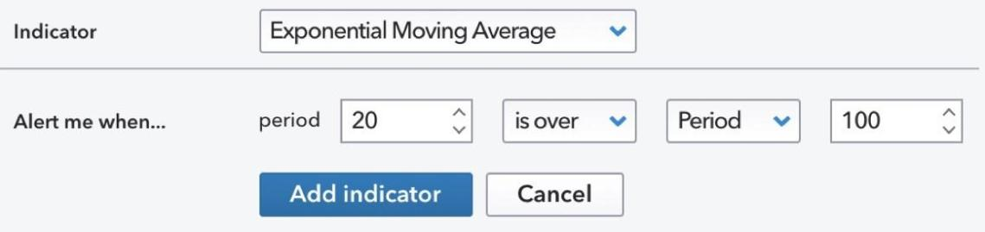
Powerful, real-time analytic processing made simple
Market Alerts and Events

Slide 27
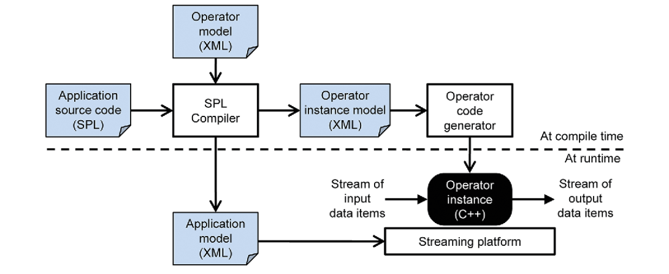
Powerful, real-time analytic processing made simple
Compiling and running a stream processing application

Slide 28
Powerful, real-time analytic processing made simple
InfoSphere Streams applications
Extended

Slide 29
Powerful, real-time analytic processing made simple
C
InfoSphere Streams applications
Extended

Slide 30
Powerful, real-time analytic processing made simple
C
InfoSphere Streams applications
Extended
C++

Slide 31
Powerful, real-time analytic processing made simple
C
InfoSphere Streams applications
Extended
C++
Java Applications

Slide 32
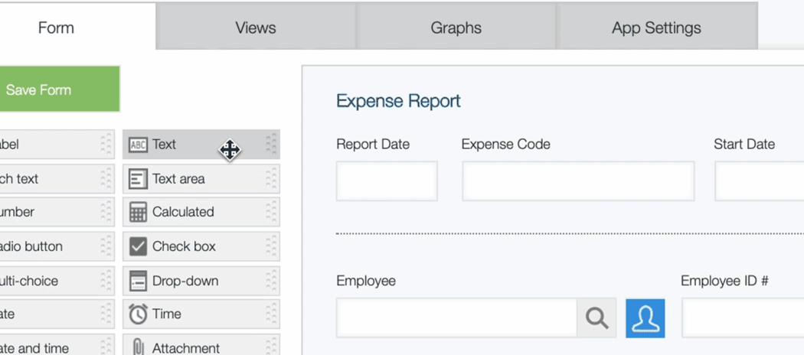
Powerful, real-time analytic processing made simple
Drag-and-drop visual development

Slide 33
Enterprise integration: Extending the power of InfoSphere Streams
IBM InfoSphere BigInsights™
IBM InfoSphere Data Explorer
IBM InfoSphere DataStage
Support for XML

Slide 34
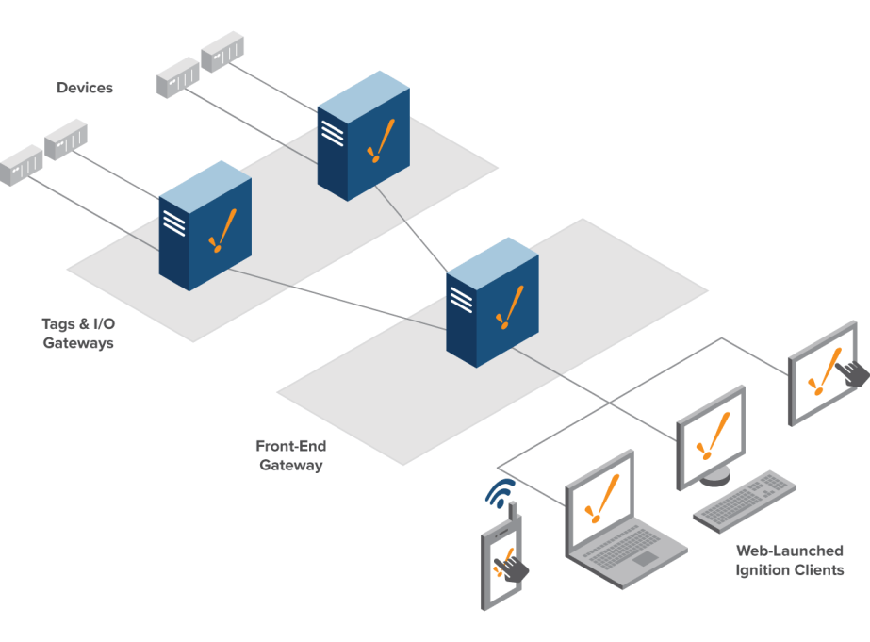
Scale-out architecture

Slide 35
Comprehensive tools for an agile development environment
InfoSphere Streams Debugger
The drag-and-drop graphical editor
An instance graph
The latest InfoSphere Streams data visualization capabilities

Slide 36

Sophisticated analytics with toolkits and accelerators

Slide 37
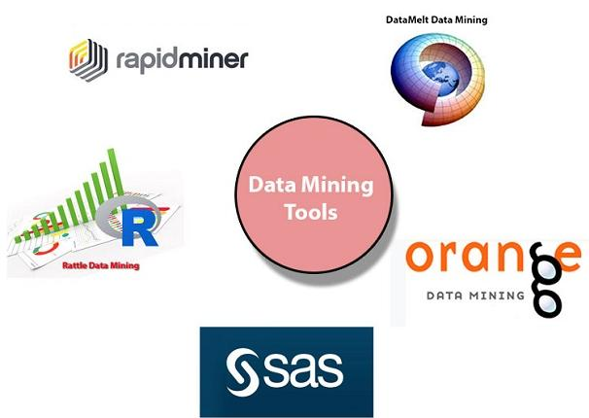
Sophisticated analytics with toolkits and accelerators
Data Mining Toolkit

Slide 38
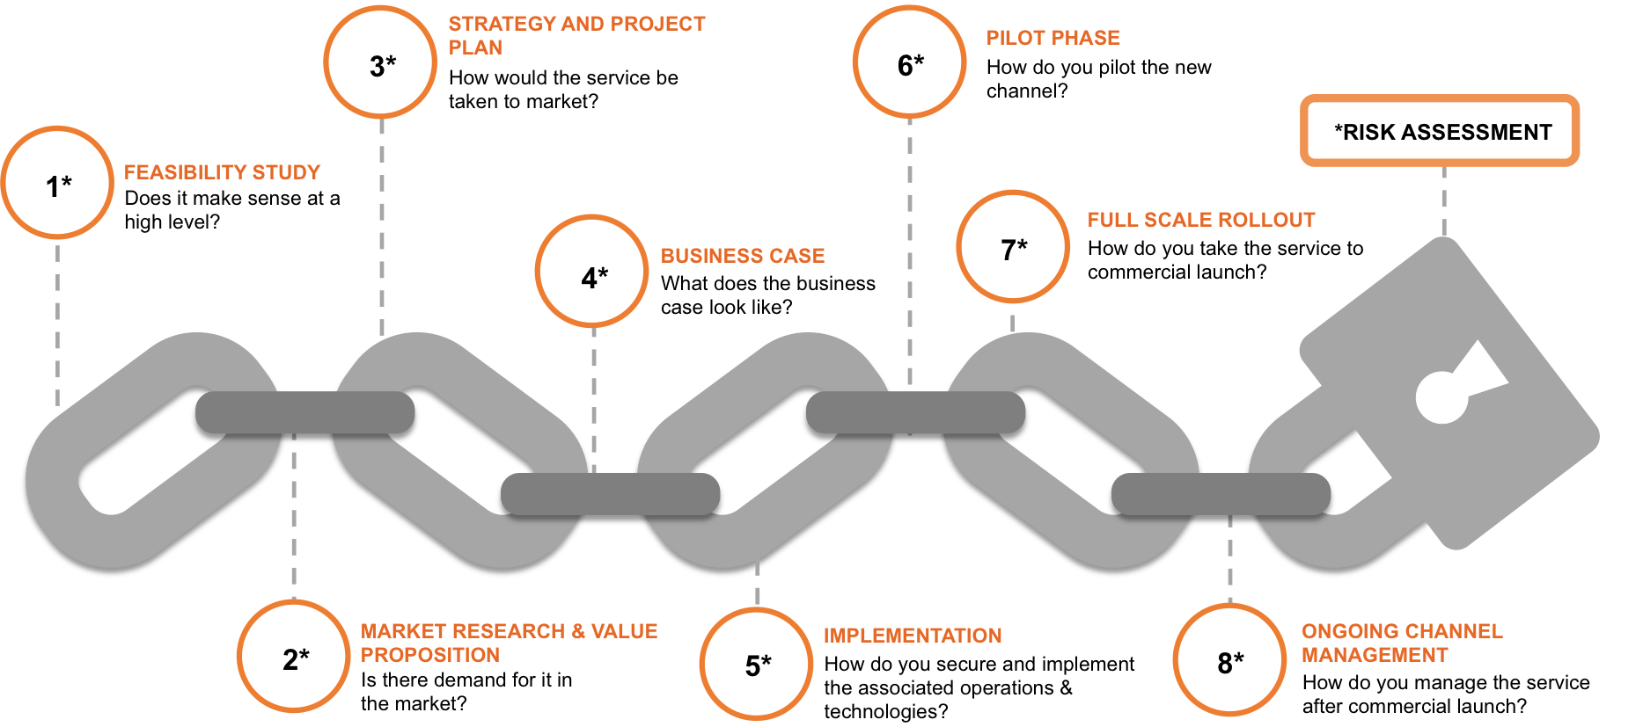
Sophisticated analytics with toolkits and accelerators
Financial Services Toolkit

Slide 39
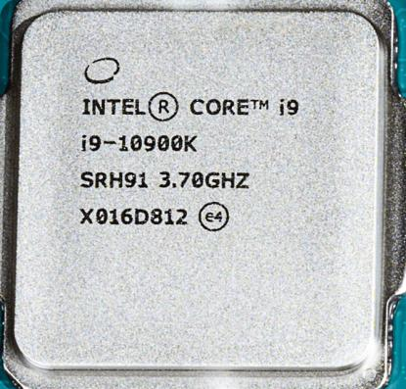
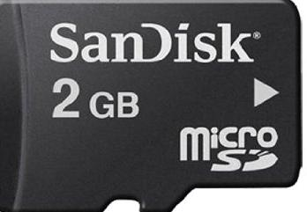
InfoSphere Streams: System requirements
HARDWARE REQUIREMENTS

Slide 40
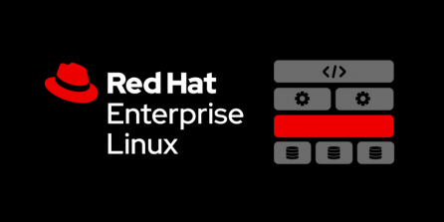
InfoSphere Streams: System requirements
SOFTWARE REQUIREMENTS

Slide 41

InfoSphere Streams: System requirements
SOFTWARE REQUIREMENTS

Slide 42
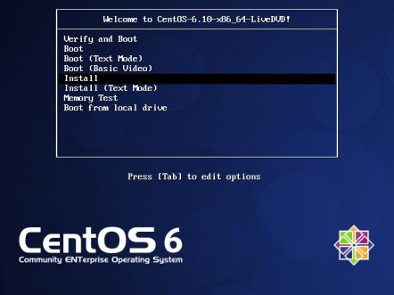
InfoSphere Streams: System requirements
SOFTWARE REQUIREMENTS

Slide 43

InfoSphere Streams: System requirements
SOFTWARE REQUIREMENTS

Slide 44
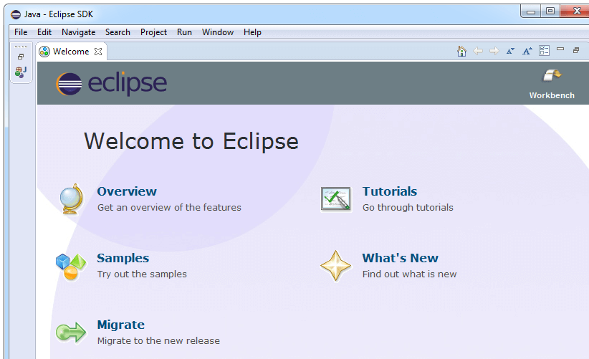
InfoSphere Streams: System requirements

Slide 45
InfoSphere Streams: System requirements

Slide 46

InfoSphere Streams: System requirements

Slide 47

InfoSphere Streams: System requirements

Slide 48
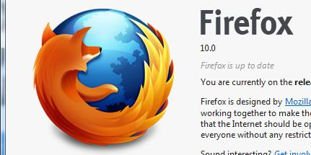
InfoSphere Streams: System requirements

Slide 49
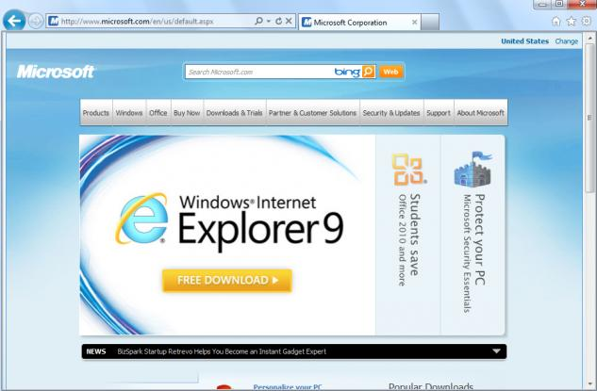
InfoSphere Streams: System requirements

Slide 50
Other toolkits in InfoSphere Streams include
Complex Event Processing (CEP)
InfoSphere Data Explorer
InfoSphere DataStage
IBM SPSS

Slide 51
Other toolkits in InfoSphere Streams include
Geospatial
Messaging
Time series

